Slide 1
Workshop on Redis
Presenter
Baburam Chaudhary
M.Tech in AI (2022)
DoCSE, KU
Date: 27 Aug, 2023

Slide 2
Contents
Introduction to Redis
Client Libraries and Interfaces
Data Types in Redis
Basic Operations
Persistence and Durability
Transactions and Atomicity
Drawbacks of Redis
Security
Use Cases
Hands-on Excercises

Slide 3

Introduction to Redis
What is Redis?
Redis (REmote DIctionary Server) is an
open-source in-memory storage, used as a
distributed, in-memory key-value database,
cache and message broker, with optional durability.
Initial release: May 10, 2009,
It was written in ANSI C, and works on most POSIX systems like Linux, *BSD, and Mac OS X without external dependencies.
There is no official support for Windows builds. To install Redis on Windows, you’ll first need to enable WSL2.
NoSQL database.

Slide 4






Introduction to Redis (contd.)
It is often referred to as a data structure server, since the keys can contain strings, lists, sets, sorted sets, hashes, etc.
Redis is used in companies like:
Twitter
Airbnb
Adobe
Amazon
Tinder
Yahoo

Slide 5
Introduction to Redis (contd.)
Why use Redis?
Redis is an advanced key-value store that can function as a NoSQL database or as a memory-cache store to improve performance when serving data that is stored in system memory.
It is used as cache, and message broker.
Very flexible.
Very Fast: Can perform around 110,000 SETs per second, about 81,000 GETs per second.
Rich Datatype Support
Redis supports the use of pub/sub channels for fast data sharing between applications.

Slide 6
Introduction to Redis (contd.)
How to interact with Redis?
Once installed in a server, run the Redis CLI (Command Line Interface) to issue commands to Redis. While working on the CLI tool, your command-line prompt will change to:
redis>
or (in case of local server)
127.0.0.1:6379>

Slide 7
Introduction to Redis (contd.)
Key features and advantages
In-memory data structures
Well-known as a “data structure server”, with support for strings, hashes, lists, sets, sorted sets, streams, and more.
Programmability
Redis provides a built-in scripting engine that supports Lua, it allows developers to write and execute scripts that manipulate data stored in a Redis database.
Extensibility
A module API for building custom extensions to Redis in C, C++, and Rust and most of the languages.
Persistence
Keeps the dataset in memory for fast access, but can also persist all writes to permanent storage to survive reboots and system failures.
Clustering
Horizontal scalability with hash-based sharding, scaling to millions of nodes with automatic repartitioning when growing the cluster.

Slide 8
Introduction to Redis (contd.)
Key features and advantages
6. High availability
Replication with automatic failover for both standalone and clustered deployments.
7. Real-time data store
Redis’ versatile in-memory data structures enable building data infrastructure for real-time applications that require low latency and high-throughput.
8. Caching & session storage
Redis’ speed makes it deal for caching database queries, complex computations, API calls, and session state.
9. Streaming & messaging
The stream data type enables high-rate data ingestion, messaging, event sourcing, and notifications.

Slide 9
Client Libraries and Interfaces
There are client libraries and interfaces available in various programming languages to simplify the process of interacting with the Redis server. These libraries provide convenient ways to send commands to the Redis server and receive responses. Some of the popular Redis client libraries and interfaces include:
redis-py (Python): redis-py is the official Redis client for Python. It provides an intuitive way to interact with Redis servers using Python code.
Jedis (Java): A popular popular Redis client library for java.
ioredis (JavaScript/Node.js): ioredis is a robust Redis client for Node.js.
redis-rb (Ruby): The redis gem is a popular client library for Ruby.

Slide 10
Client Libraries and Interfaces (contd.)
There are also various tools and interfaces that provide graphical or command-line ways to interact with Redis servers.
Redis CLI: The Redis command-line interface is a built-in tool that allows direct interaction with a Redis server from the command line. It's a powerful way to execute Redis commands and manage data.
RedisInsight: RedisInsight is a graphical user interface (GUI) tool provided by Redis Labs. It offers a user-friendly way to visualize and manage Redis data and operations.
phpRedisAdmin: phpRedisAdmin is a web-based management tool for Redis that provides an interface for browsing and managing Redis databases.
These client libraries and interfaces collectively make working with Redis more accessible and efficient for developers in various programming languages and environments.

Slide 11
Data Types in Redis
Strings: Redis strings are the most basic Redis data type, representing a sequence of bytes.
Lists: Redis lists are lists of string sorted by insertion order.
Sets: Redis sets are unordered collections of unique strings that act like the sets in Python programming.
Hashes: Redis hashes are record types modeled as collections of field-value pairs. Redis hashes resemble python dictionaries.
Sorted Sets: Redis sorted sets are collections of unique strings that maintain order by each string’s associated score.
Bitmaps and HyerLogLogs: Bitmaps let you perform bitwise operations on strings, and HyperLogLogs data structures provide probabilistic estimates of the cardinality (i.e., number of elements) of large sets.
Geospatial indexes: Redis geospatial indexes are useful for finding locations within a given geographic radius or bounding box.

Slide 12
Basic Operations
Connecting to a Redis server: (for local environment)
using redis server CLI:
$ sudo service redis-server start
$ redis-cli
127.0.0.1:6379>
using redis Python:
import redis
r = redis.Redis(host=“localhost”, port=6379)
Setting and retrieving values
$ set key1 “Hello World” // set key value
$ get key1 // get key
using redis Python
r.set(name=“key1”, value=“Hello World”)
get_value = r.get(name=“key1”)
print(get_value)

Slide 13
Basic Operations (contd.)
3. Expire and TTL (Time To Live) for keys
$ SET otp “4920” EX 30 // here key otp is valid for 30 seconds, after that it will be automatically deleted.
$ TTL otp // get how many seconds is remaining.
4. Incrementing and decrementing values
$ SET key1 “10” $ DECR key1 // decrease value by 1
$ GET key1 // output: 10 $ GET key1 // output: 10
$ INCR key1
$ GET key1 // output: 11
5. Deleting keys
$ DEL otp key1

Slide 14
Persistence and Durability
RDB(Redis Database) snapshots:
RDB persistence performs point-in-time snapshots of your dataset at specified intervals.
AOF(Append Only File) logs:
AOF persistence logs every write operation received by the server. For instance, we can set AOF after every 10 SET operations.
RDB + AOF: You can also combine both AOF and RDB in the same instance.

Slide 15
Transactions and Atomicity
Redis Transactions allow the execution of a group of commands in a single step, they are centered around the commands MULTI, EXEC, DISCARD and WATCH.
Redis Transactions make two important guarantees:
All the commands in a transaction are serialized and executed sequentially . A request sent by another client will never be served in the middle of the execution of a Redis Transaction.
EXEC command triggers the execution of all the commands in the transaction, so if a client losses the connection to the server before calling EXEC command none of the operations are performed, instead if EXEC command is called, all the operations are performed.

Slide 16
Drawbacks of Using Redis
1. One of the main drawbacks of Redis is that it stores data entirely in memory, which means that it can be sensitive to data loss in the event of a crash or shutdown. To address this issue, Redis provides features such as persistence and replication, which allow data to be saved to disk and replicated across multiple servers. However, these features can add complexity and overhead, which may not be suitable for all applications.
2. Redis is a single-threaded system, which means that it can only process one command at a time. This can limit the performance and scalability of Redis in applications that require high concurrency and parallelism. To address this issue, Redis provides clustering and sharding features that allow data to be distributed across multiple servers, but these features can be complex to set up and manage.

Slide 17
Security
Designed to be accessed by trusted clients.
Do not allow external / internet exposure.
Simple authentication can be setup.
Can be restricted to certain interfaces.

Slide 18
Use Cases
1. Real-time analytics: Applications can use Redis to store and process large amounts of data in real-time, allowing organizations to quickly analyze and visualize data to make business decisions.
2. Online gaming: Gaming software can use Redis to store and manage game state, such as player profiles, game scores, and leaderboards, which allows for fast and seamless gameplay.
3. E-commerce: Ecommerce apps can use Redis to store and manage data related to online shopping, such as product catalogs, user profiles, and shopping cart contents, which enables fast and efficient shopping experiences for users.
4. Social media: Social apps can use Redis to store and manage data related to social media interactions, such as user profiles, friend lists, and news feeds, which allows for fast and smooth user experiences.

Slide 19
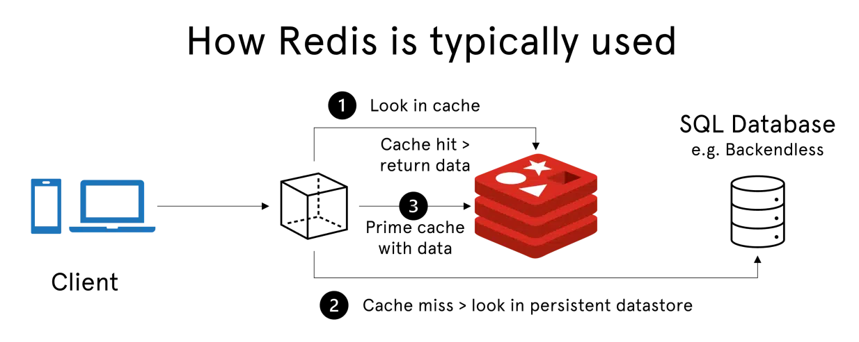
Use Cases
5. Using Redis as a cache.
Cache eviction policies (LRU(Least Recently Used), LFU(Least Frequently Used), etc.)
Cache invalidation strategies: Expiry(TTL), for instance,
$ SET a 10 EX 60 // Here, key a will be expire after 60 seconds.
Figure: How Redis Typically Works

Slide 20
Hands-on Excercises
SetUp
Linux System
Open the Terminal and type following command
$ sudo apt-get update
$ sudo apt-install redis
That’s it redis is installed in your Linux system.
2. For Redis-py, enter following command in Terminal
$ pip install redis

Slide 21
Reference
1. redis.io/docs/

Slide 22
Thank YOU

